Slide 1
COVIBLOCK: A Merkle DAG and Blockchain Implementation for COVID-19 Records
Presented by: Jennifer L. Fadriquela

Slide 2
Background
At present, Ospital ng Makati is using a system for keeping COVID-19 Test Results while vaccination records are maintained on a separate system used by the entire City of Makati.
The patients only receive physical copies of these records as proof of execution. Current setup for organizing and managing these records still has shortcomings.

Slide 3
Objectives
To develop an application that will decentralize storage of COVID-19 related files.
1
To provide an alternative way to minimize record tampering of uploaded files in CoviBlock by applying concepts of Merkle DAG and Proof of Authority (PoA) blockchain.
2
3
To secure uploaded files in CoviBlock by using asymmetric cryptography.

Slide 4
Scope and Limits
Exclude test results generation and vaccine management.
1
Assumes outputs are already generated in computer readable format such as images (.png, .jpg) or documents (.pdf).
2
3
Will focus on Test Results and Vaccine Certificates.

Slide 5
Blockchain
A technology that permits a network of computers to have a consensus on the true status of a distributed ledger at regular intervals.

Slide 6
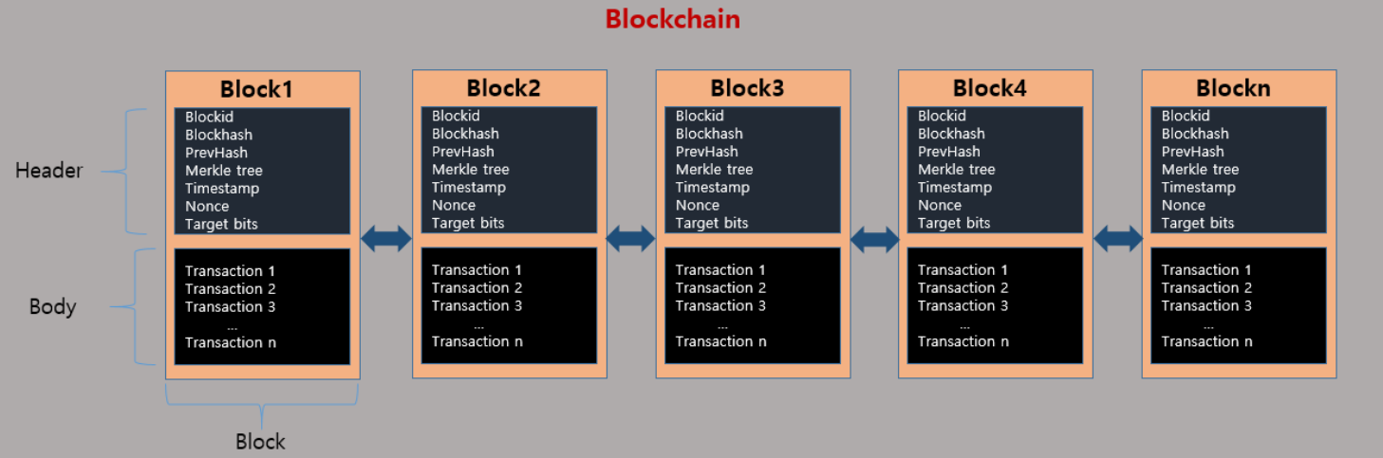
Blockchain
A chain of blocks, blocks are like tables in the database, but they cannot be deleted or updated, blocks contain information. The blocks are cryptographically verified and chained up to form an immutable chain of blocks called a blockchain or ledger.
Notes:
https://medium.com/swlh/is-it-hard-to-build-a-blockchain-from-scratch-2662e9b873b7

Slide 7
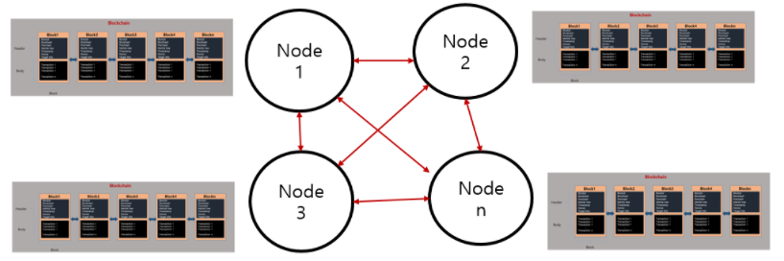
Blockchain
The same chain is then distributed to all the nodes (computers or miners) across the network via a P2P network.

Slide 8
Blockchain
Below are main features of a blockchain: Decentralization: Instead of relying on a single trusted entity, trust is spread across multiple or all participants, depending on the agreed-upon consensus algorithm.
Immutability: Once data is committed to the blockchain and enough participants have agreed on this state, the information is stored permanently and immutably.
Scalability: The block rate, comprised of the throughput and propagation time of information, depends on the consensus algorithm and the number of participants.
Limited privacy: All data in the blockchain is publicly visible to all participants. Private or permissioned blockchains limit the range of disclosure.
Notes:
https://jis-eurasipjournals.springeropen.com/articles/10.1186/s13635-019-0085-3
Decentralization: Instead of relying on a single trusted entity, trust is spread across multiple or all participants, depending on the agreed-upon consensus algorithm [10]. This does not only mean that multiple copies of a data item are stored on all nodes, but also that the integrity of the data is governed by many decentralized parties.
Immutability: Once data is committed to the blockchain and a sufficient number of participants have agreed on this state, the information is stored permanently and immutably. Changing the information contained in a particular block would require to also change all the following blocks up to the last block, which is considered to be infeasible [1, 11].
Scalability: The block rate, comprised of the throughput and propagation time of information, depends on the consensus algorithm and the number of participants. This can be a limiting factor for applications that require high throughput [10]. Since all nodes hold a copy of the blockchain, scalability issues also arise in terms of the total amount of data that can be stored. Furthermore, in order to check the integrity of the blockchain, a new node needs to download a copy and validate the integrity of the entire chain. Note that more recent proposals for BFT-based consensus algorithms improved on this, e.g., [12].
Limited privacy: All data in the blockchain is publicly visible to all participants. Private or permissioned blockchains limit the range of disclosure. However, they do not cryptographically protect the data. In order to achieve privacy, additional layers, such as zero-knowledge proofs [13] or a commitment scheme are required [14].

Slide 9
Proof of Authority
A set of trusted nodes called Authorities, each recognized by their unique identifier, are responsible for mining and validating the blocks in the blockchain.

Slide 10
Proof of Authority
Clique is a type of consensus protocol referred to as the Proof of Authority (or PoA for short).
In a PoA consensus algorithm, a set of trusted nodes known as Authorities, each identified by their unique identifier, are responsible for mining and validating the blocks in the blockchain.
Each block is produced by an authority at a fixed interval. The responsibility of creating the next block is shared amongst the set of authorities and is done in a round-robin fashion.

Slide 11
Proof of Authority
The Clique consensus protocol adheres to the following rules:
- Set of trusted authorities are referred to as the "Signers"
- Process of mining a block is referred to as "Sealing a block"
- WHEN the next block is identified by BLOCK_NUMBER and the number of signers is identified by SIGNER_COUNT
- AND the signers are lexicographically sorted by their unique identifiers in a list
- THEN the next block is sealed by the signer located at the index
- BLOCK_NUMBER % SIGNER_COUNT, where % is the modulus operator

Slide 12
IPFS
A distributed platform for storing and retrieving files, websites, applications and data.

Slide 13
IPFS – Content Addressing
IPFS uses content addressing to identify content by what's in it rather than by where it's located.
Right now, content is found by location, such as:
- https://en.wikipedia.org/wiki/Aardvark
- /Users/Alice/Documents/term_paper.doc
- C:\Users\Joe\My Documents\project_sprint_presentation.ppt
IPFS uses content addressing the way HTTP uses URLs. This means that instead of creating identifiers that address artifacts by location, we can address them by some representation of the content itself.
Notes:
https://blog.infura.io/an-introduction-to-ipfs/

Slide 14
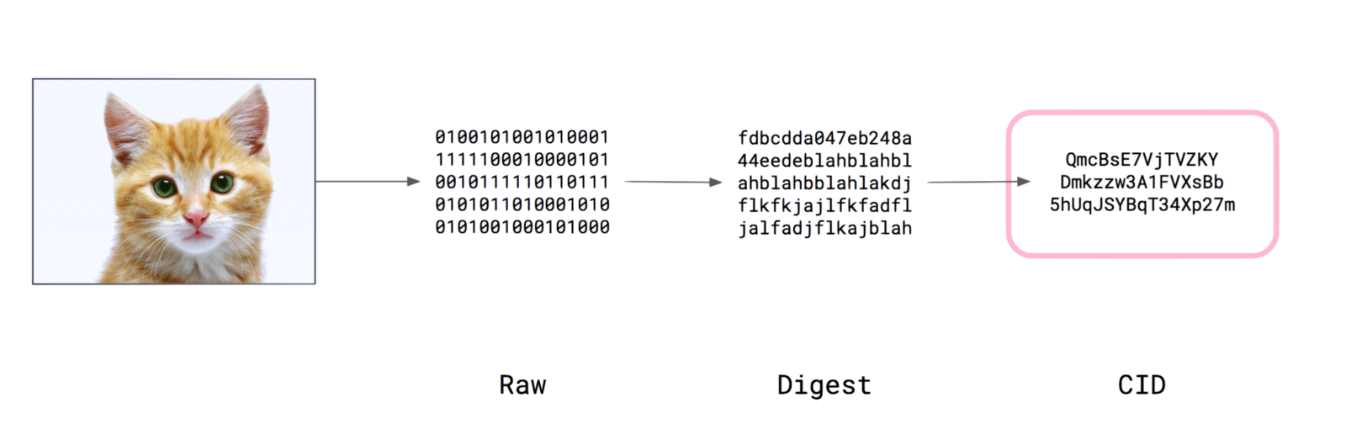
IPFS – Content Addressing
Notes:
https://blog.infura.io/an-introduction-to-ipfs/

Slide 15
IPFS – Merkle DAG
A Merkle DAG is a DAG where each node has an identifier, and this is the result of hashing the node's contents — any opaque payload carried by the node and the list of identifiers of its children — using a cryptographic hash function like SHA256.
- Merkle DAGs can only be constructed from the leaves, that is, from nodes without children.
- Every node in a Merkle DAG is the root of a (sub)Merkle DAG itself, and this subgraph is contained in the parent DAG.
- Merkle DAG nodes are immutable.

Slide 16
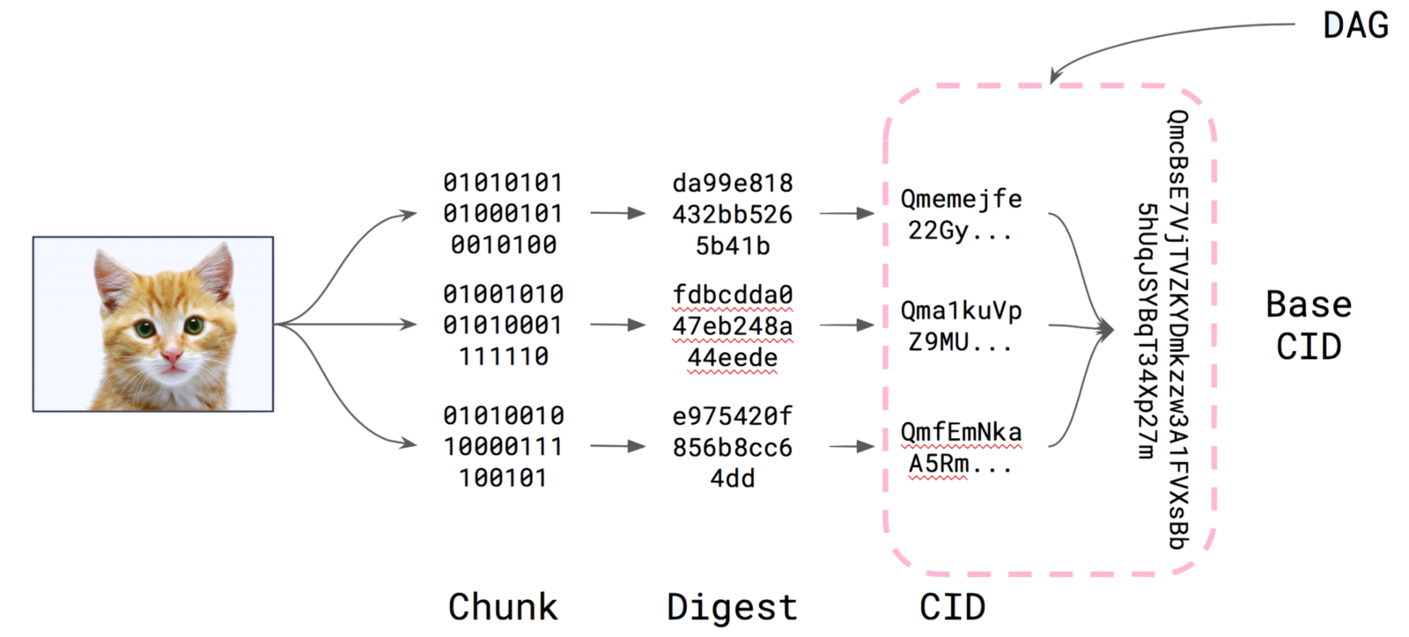
IPFS – Merkle DAG

Slide 17
IPFS – Distributed Hash Table
To find which peers are hosting the content you're after (discovery), IPFS uses a distributed hash table, or DHT.
A hash table is a database of keys to values. A distributed hash table is one where the table is split across all the peers in a distributed network. To find content, you ask these peers.
The libp2p project is the part of the IPFS ecosystem that provides the DHT and handles peers connecting and talking to each other

Slide 18
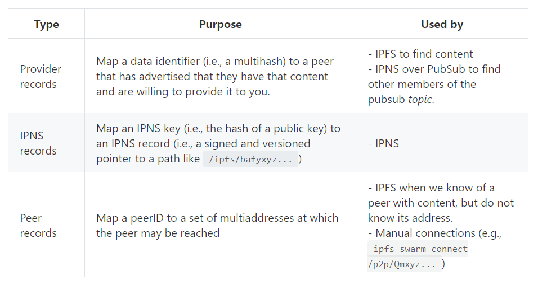
IPFS – Distributed Hash Table
There are three types of key-value pairings that are mapped using the DHT:

Slide 19
Asymmetric Cryptography
Process that uses a pair of related keys to encrypt and decrypt a message and protect it from unauthorized access or use.

Slide 20
Asymmetric Cryptography
The two participants in the asymmetric encryption workflow are the sender and the receiver; each has its own pair of public and private keys.
- First, the sender obtains the receiver's public key.
- Next, the plaintext is encrypted by the sender using the receiver's public key; this creates ciphertext.
- The ciphertext is then sent to the receiver, who decrypts the ciphertext with their private key and returns it to legible plaintext.
Because of the one-way nature of the encryption function, one sender is unable to read the messages of another sender, even though each has the public key of the receiver.
Notes:
https://searchsecurity.techtarget.com/definition/asymmetric-cryptography

Slide 21
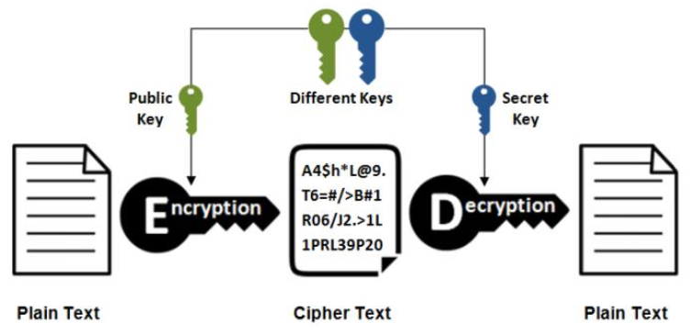
Asymmetric Cryptography
Notes:
https://searchsecurity.techtarget.com/definition/asymmetric-cryptography

Slide 22
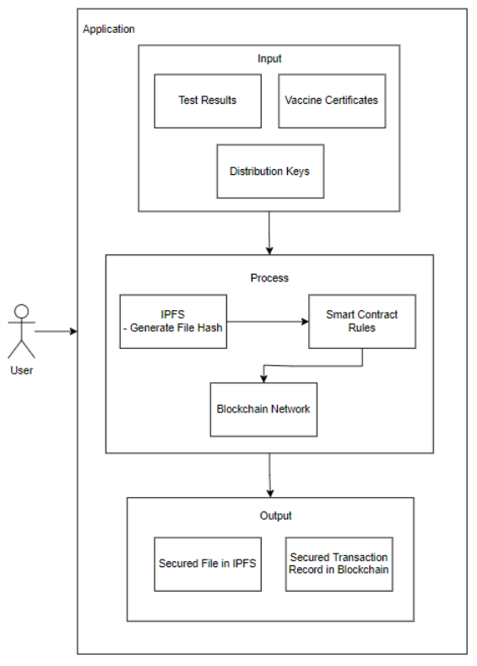
Conceptual Framework

Slide 23


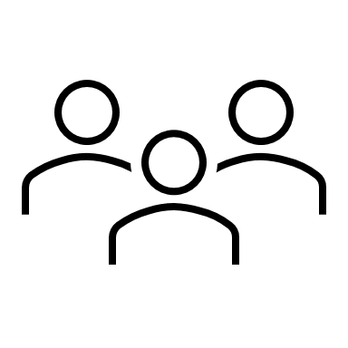
User Roles
Patient
- Grant Access
- View Own Record
Medical Unit
- Upload record
Third Party
- View Patient Record
Notes:
Patient
- Register and Login – register to gain access to the system
- Grant Access – Grant access to file requestors
- View Own Record – Get access to own results/certificate
Verifying Third Party
- Register and Login – register to gain access to the system
- View Patient Record – retrieve and view patient record if was given access
Physician/Medical Unit
- Register and Login – register to gain access to the system
Upload record – upload a record for the patient
Patients. Above all, patients will greatly benefit on this application. Various regulations and laws have been implemented to ensure people are not spreaders or vaccinated. Currently, there are no unified way in getting and presenting these records are proof. More so, bad actors are using this pandemic to make money out of tampering records. The application will help solve the woes of patients in terms on ease of access and portability of their records. They will also have full autonomy of said records.
Medical Personnel. The application will help medical workers to focus on their medical line of duty and alleviating various admin jobs.
Third Party Validators. As mentioned above, records tampering has become rampant. Businesses or employers requiring such records can now be protected of this illegal activity

Slide 24
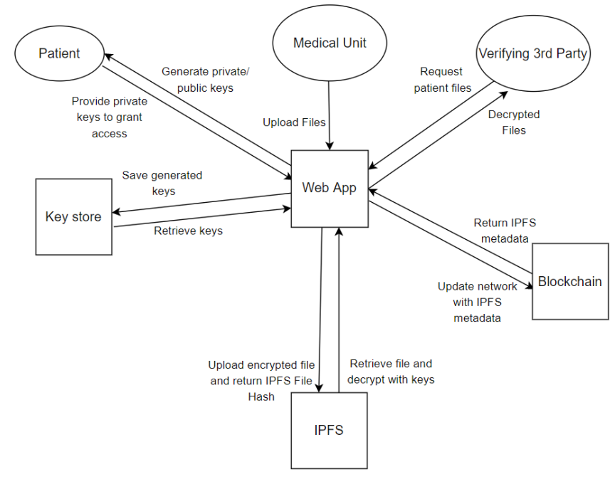
Data Flow Diagram

Slide 25
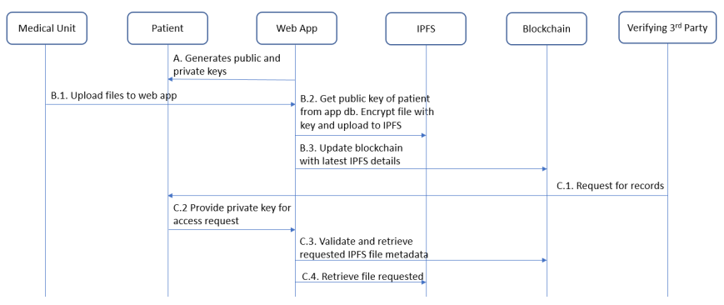
Transaction Diagram

Slide 26
END

